Slide 1
Bootstrap Grid System
廖向德

Slide 2
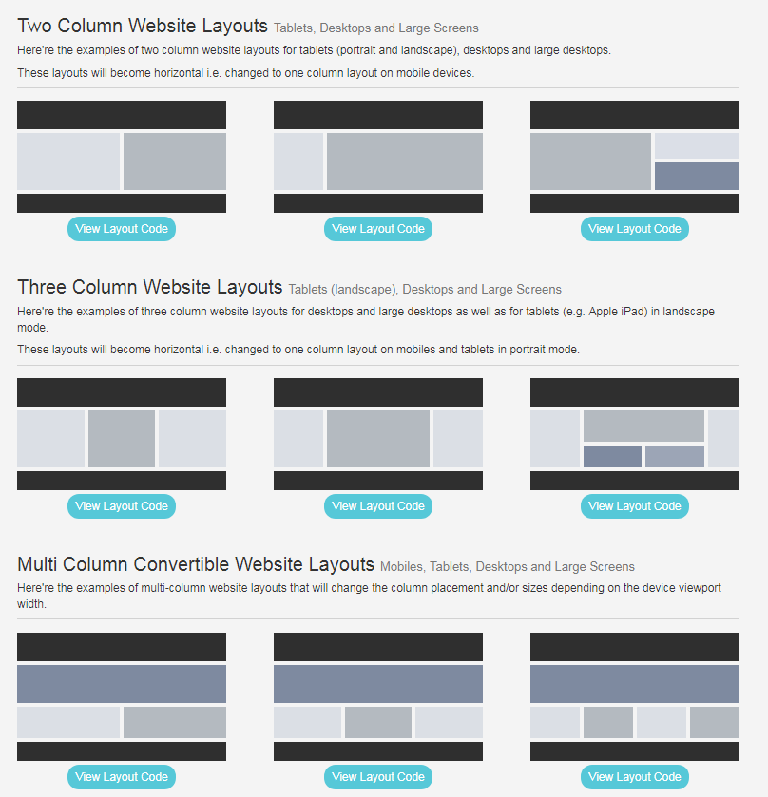
Bootstrap Grid Examples
https://www.tutorialrepublic.com/twitter-bootstrap-tutorial/bootstrap-grid-examples.php

Slide 3
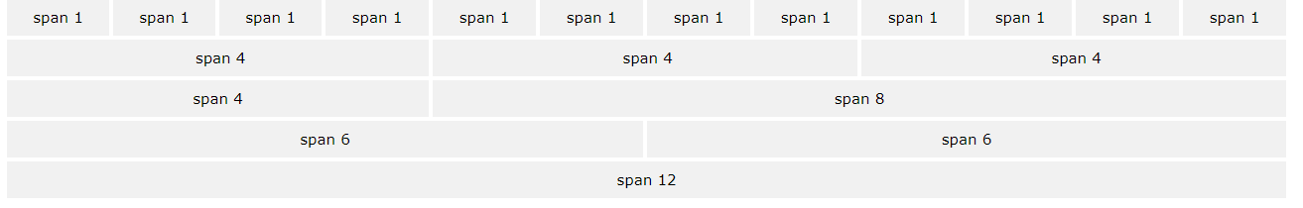
Very import! 12 columns!
Bootstrap's grid system allows up to 12 columns across the page.
If you do not want to use all 12 columns individually, you can group the columns together to create wider columns:
Bootstrap's grid system is responsive, and the columns will re-arrange automatically depending on the screen size.

Slide 4
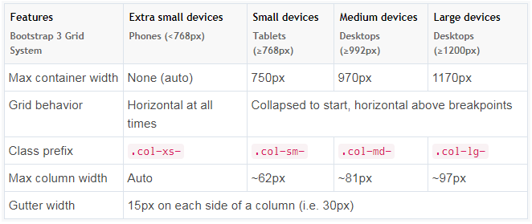
Grid Classes
Applying any .col-sm-* class to an element will not only affect its styling on small devices, but also on medium and large devices having a screen size greater than or equal to 768px (i.e. ≥768px) if .col-md-* and .col-lg-* class is not present. Similarly the .col-md-* class.

Slide 5
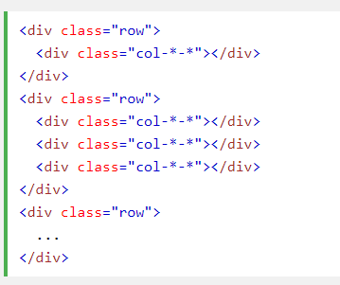
Basic Structure of a Bootstrap Grid

Slide 6
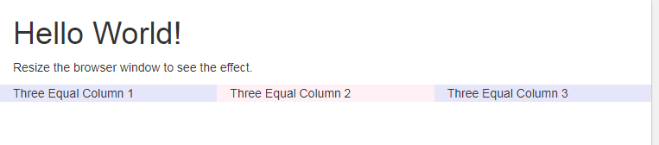
Practice 1
Try to make three equal columns
Make sure it always keep three column at all time no matter what device size is
Notes:
https://www.w3schools.com/bootstrap/tryit.asp?filename=trybs_grid_ex1&stacked=h

Slide 7
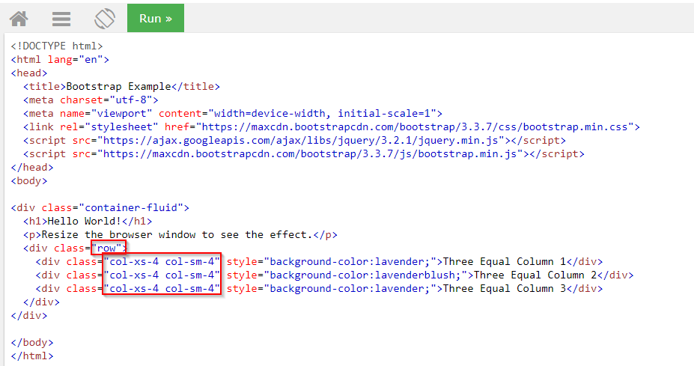
Answer 1
Notes:
<!DOCTYPE html>
<html lang="en">
<head>
<title>Bootstrap Example</title>
<meta charset="utf-8">
<meta name="viewport" content="width=device-width, initial-scale=1">
<link rel="stylesheet" href="https://maxcdn.bootstrapcdn.com/bootstrap/3.3.7/css/bootstrap.min.css">
<script src="https://ajax.googleapis.com/ajax/libs/jquery/3.2.1/jquery.min.js"></script>
<script src="https://maxcdn.bootstrapcdn.com/bootstrap/3.3.7/js/bootstrap.min.js"></script>
</head>
<body>
<div class="container-fluid">
<h1>Hello World!</h1>
<p>Resize the browser window to see the effect.</p>
<div class="row">
<div class="col-xs-4 col-sm-4" style="background-color:lavender;">Three Equal Column 1</div>
<div class="col-xs-4 col-sm-4" style="background-color:lavenderblush;">Three Equal Column 2</div>
<div class="col-xs-4 col-sm-4" style="background-color:lavender;">Three Equal Column 3</div>
</div>
</div>
</body>
</html>

Slide 8
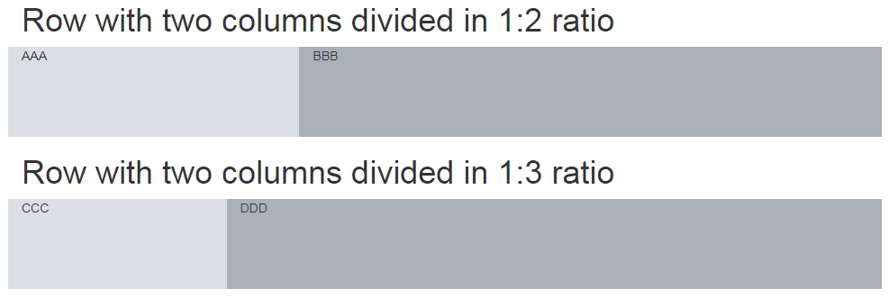
Practice 2
Try different column ratio

Slide 9
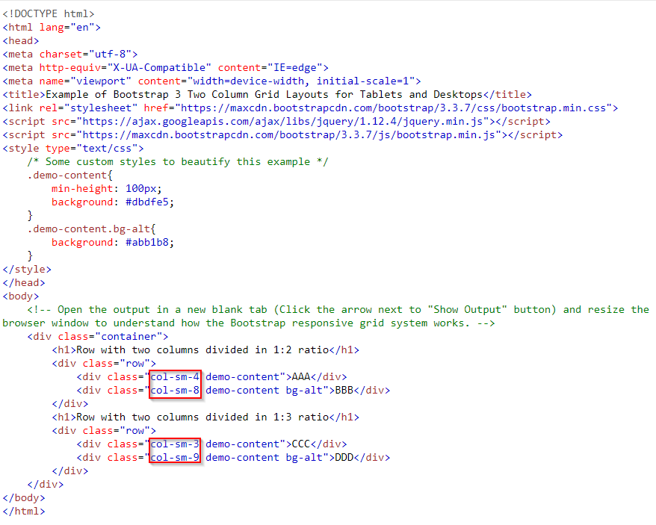
Answer 2
Notes:
<!DOCTYPE html>
<html lang="en">
<head>
<meta charset="utf-8">
<meta http-equiv="X-UA-Compatible" content="IE=edge">
<meta name="viewport" content="width=device-width, initial-scale=1">
<title>Example of Bootstrap 3 Two Column Grid Layouts for Tablets and Desktops</title>
<link rel="stylesheet" href="https://maxcdn.bootstrapcdn.com/bootstrap/3.3.7/css/bootstrap.min.css">
<script src="https://ajax.googleapis.com/ajax/libs/jquery/1.12.4/jquery.min.js"></script>
<script src="https://maxcdn.bootstrapcdn.com/bootstrap/3.3.7/js/bootstrap.min.js"></script>
<style type="text/css">
/* Some custom styles to beautify this example */
.demo-content{
min-height: 100px;
background: #dbdfe5;
}
.demo-content.bg-alt{
background: #abb1b8;
}
</style>
</head>
<body>
<!-- Open the output in a new blank tab (Click the arrow next to "Show Output" button) and resize the browser window to understand how the Bootstrap responsive grid system works. -->
<div class="container">
<h1>Row with two columns divided in 1:2 ratio</h1>
<div class="row">
<div class="col-sm-4 demo-content">AAA</div>
<div class="col-sm-8 demo-content bg-alt">BBB</div>
</div>
<h1>Row with two columns divided in 1:3 ratio</h1>
<div class="row">
<div class="col-sm-3 demo-content">CCC</div>
<div class="col-sm-9 demo-content bg-alt">DDD</div>
</div>
</div>
</body>
</html>

Slide 10
Practice 3
What will happen when grid columns are more than 12?
If more than 12 grid columns are placed within a single row, then each group of extra columns, as a whole, will wrap onto a new line.

Slide 11
Practice 4
Create a three column layout on medium devices like laptops and desktops, as well as on tablets (e.g. Apple iPad) in landscape mode
But on small devices like tablets in portrait mode, it will change into a two column layout where the third column moves at the bottom of the first two columns.

Slide 12
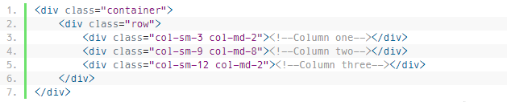
Answer 4
https://www.w3schools.com/code/tryit.asp?filename=FK2R59JRHZHK
Notes:
<!DOCTYPE html>
<html lang="en">
<head>
<meta charset="utf-8">
<meta http-equiv="X-UA-Compatible" content="IE=edge">
<meta name="viewport" content="width=device-width, initial-scale=1">
<title>Example of Bootstrap 3 Column Wrapping</title>
<link rel="stylesheet" href="https://maxcdn.bootstrapcdn.com/bootstrap/3.3.7/css/bootstrap.min.css">
<script src="https://ajax.googleapis.com/ajax/libs/jquery/1.12.4/jquery.min.js"></script>
<script src="https://maxcdn.bootstrapcdn.com/bootstrap/3.3.7/js/bootstrap.min.js"></script>
<style type="text/css">
/* Some custom styles to beautify this example */
.demo-content{
padding: 15px;
font-size: 18px;
min-height: 100px;
background: #dbdfe5;
margin-bottom: 10px;
}
.demo-content.bg-alt{
background: #abb1b8;
}
</style>
</head>
<body>
<!-- Open the output in a new blank tab (Click the arrow next to "Show Output" button) and resize the browser window to understand how the Bootstrap responsive grid system works. -->
<div class="container">
<div class="row">
<div class="col-sm-3 col-md-2">
<div class="demo-content">.col-sm-3 .col-md-2</div>
</div>
<div class="col-sm-9 col-md-8">
<div class="demo-content bg-alt">.col-sm-9 .col-md-8</div>
</div>
<div class="col-sm-12 col-md-2">
<div class="demo-content flexible">.col-sm-12 .col-md-2</div>
</div>
</div>
</div>
</body>
</html>

Slide 13
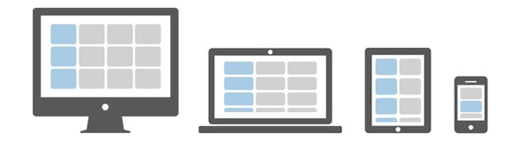
Practice 5
12 content boxes in all devices
mobile device : 12 rows x 1 column
tablet : 6 rows x 2 columns
medium screen size devices: 4 rows x 3 columns
large screen devices : 3 rows x 4 columns

Slide 14
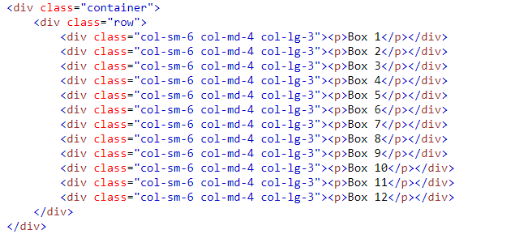
Answer 5
https://www.w3schools.com/code/tryit.asp?filename=FK2R3SW2KTM3
Notes:
<!DOCTYPE html>
<html lang="en">
<head>
<meta charset="utf-8">
<meta http-equiv="X-UA-Compatible" content="IE=edge">
<meta name="viewport" content="width=device-width, initial-scale=1">
<title>Example of Bootstrap 3 Multi-Column Grid Layout for All Devices</title>
<link rel="stylesheet" href="https://maxcdn.bootstrapcdn.com/bootstrap/3.3.7/css/bootstrap.min.css">
<script src="https://ajax.googleapis.com/ajax/libs/jquery/1.12.4/jquery.min.js"></script>
<script src="https://maxcdn.bootstrapcdn.com/bootstrap/3.3.7/js/bootstrap.min.js"></script>
<style type="text/css">
p{
padding: 50px;
font-size: 32px;
font-weight: bold;
text-align: center;
background: #dbdfe5;
}
</style>
</head>
<body>
<!-- Open the output in a new blank tab (Click the arrow next to "Show Output" button) and resize the window to understand how the Bootstrap responsive grid system works. -->
<div class="container">
<div class="row">
<div class="col-sm-6 col-md-4 col-lg-3"><p>Box 1</p></div>
<div class="col-sm-6 col-md-4 col-lg-3"><p>Box 2</p></div>
<div class="col-sm-6 col-md-4 col-lg-3"><p>Box 3</p></div>
<div class="col-sm-6 col-md-4 col-lg-3"><p>Box 4</p></div>
<div class="col-sm-6 col-md-4 col-lg-3"><p>Box 5</p></div>
<div class="col-sm-6 col-md-4 col-lg-3"><p>Box 6</p></div>
<div class="col-sm-6 col-md-4 col-lg-3"><p>Box 7</p></div>
<div class="col-sm-6 col-md-4 col-lg-3"><p>Box 8</p></div>
<div class="col-sm-6 col-md-4 col-lg-3"><p>Box 9</p></div>
<div class="col-sm-6 col-md-4 col-lg-3"><p>Box 10</p></div>
<div class="col-sm-6 col-md-4 col-lg-3"><p>Box 11</p></div>
<div class="col-sm-6 col-md-4 col-lg-3"><p>Box 12</p></div>
</div>
</div>
</body>
</html>

Slide 15
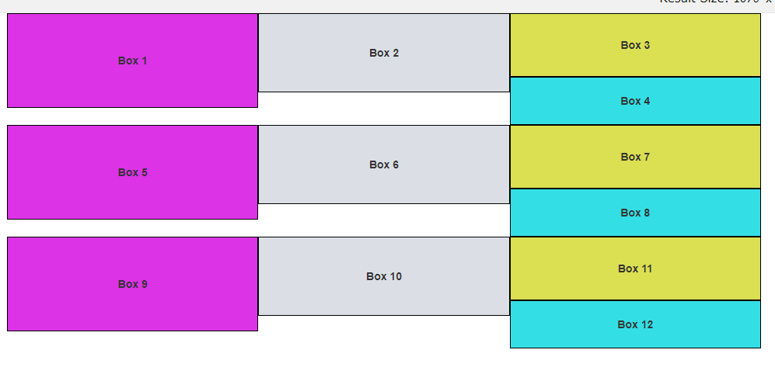
What if height of any column is taller than the other?
https://www.w3schools.com/code/tryit.asp?filename=FK2RJTMAJ6ZU
Notes:
<!DOCTYPE html>
<html lang="en">
<head>
<meta charset="utf-8">
<meta http-equiv="X-UA-Compatible" content="IE=edge">
<meta name="viewport" content="width=device-width, initial-scale=1">
<title>Example of Bootstrap 3 Multi-Column Grid Layout for All Devices</title>
<link rel="stylesheet" href="https://maxcdn.bootstrapcdn.com/bootstrap/3.3.7/css/bootstrap.min.css">
<script src="https://ajax.googleapis.com/ajax/libs/jquery/1.12.4/jquery.min.js"></script>
<script src="https://maxcdn.bootstrapcdn.com/bootstrap/3.3.7/js/bootstrap.min.js"></script>
<style type="text/css">
.t1{
padding : 50px;
font-weight: bold;
text-align: center;
background: #db33e5;
border:#000000 1px solid;
}
.t2{
padding : 40px;
font-weight: bold;
text-align: center;
background: #dbdfe5;
border:#000000 1px solid;
}
.t3{
padding : 30px;
font-weight: bold;
text-align: center;
background: #dbdf52;
border:#000000 1px solid;
}
.t4 {
padding : 20px;
font-weight: bold;
text-align: center;
background: #33dfe5;
border:#000000 1px solid;
}
</style>
</head>
<body>
<!-- Open the output in a new blank tab (Click the arrow next to "Show Output" button) and resize the window to understand how the Bootstrap responsive grid system works. -->
<div class="container">
<div class="row">
<div class="col-sm-6 col-md-4 col-lg-3 t1">Box 1</div>
<div class="col-sm-6 col-md-4 col-lg-3 t2">Box 2</div>
<div class="col-sm-6 col-md-4 col-lg-3 t3">Box 3</div>
<div class="col-sm-6 col-md-4 col-lg-3 t4">Box 4</div>
<div class="col-sm-6 col-md-4 col-lg-3 t1">Box 5</div>
<div class="col-sm-6 col-md-4 col-lg-3 t2">Box 6</div>
<div class="col-sm-6 col-md-4 col-lg-3 t3">Box 7</div>
<div class="col-sm-6 col-md-4 col-lg-3 t4">Box 8</div>
<div class="col-sm-6 col-md-4 col-lg-3 t1">Box 9</div>
<div class="col-sm-6 col-md-4 col-lg-3 t2">Box 10</div>
<div class="col-sm-6 col-md-4 col-lg-3 t3">Box 11</div>
<div class="col-sm-6 col-md-4 col-lg-3 t4">Box 12</div>
</div>
</div>
</body>
</html>

Slide 16
.clearfix & .visible-*-*
If height of any column is taller than the other it doesn't clear properly and break the layout. To fix this, use the combination of a .clearfix class and the responsive utility classes.
The responsive utility class .visible-md-block makes the .clearfix class effective only on medium size devices and it is hidden on other devices.
Notes:
<!DOCTYPE html>
<html lang="en">
<head>
<meta charset="utf-8">
<meta http-equiv="X-UA-Compatible" content="IE=edge">
<meta name="viewport" content="width=device-width, initial-scale=1">
<title>Example of Bootstrap 3 Multi-Column Grid Layout for All Devices</title>
<link rel="stylesheet" href="https://maxcdn.bootstrapcdn.com/bootstrap/3.3.7/css/bootstrap.min.css">
<script src="https://ajax.googleapis.com/ajax/libs/jquery/1.12.4/jquery.min.js"></script>
<script src="https://maxcdn.bootstrapcdn.com/bootstrap/3.3.7/js/bootstrap.min.js"></script>
<style type="text/css">
.t1{
padding : 50px;
font-weight: bold;
text-align: center;
background: #db33e5;
border:#000000 1px solid;
}
.t2{
padding : 40px;
font-weight: bold;
text-align: center;
background: #dbdfe5;
border:#000000 1px solid;
}
.t3{
padding : 30px;
font-weight: bold;
text-align: center;
background: #dbdf52;
border:#000000 1px solid;
}
.t4 {
padding : 20px;
font-weight: bold;
text-align: center;
background: #33dfe5;
border:#000000 1px solid;
}
</style>
</head>
<body>
<!-- Open the output in a new blank tab (Click the arrow next to "Show Output" button) and resize the window to understand how the Bootstrap responsive grid system works. -->
<div class="container">
<div class="row">
<div class="col-sm-6 col-md-4 col-lg-3 t1">Box 1</div>
<div class="col-sm-6 col-md-4 col-lg-3 t2">Box 2</div>
<div class="clearfix visible-sm-block"></div>
<div class="col-sm-6 col-md-4 col-lg-3 t3">Box 3</div>
<div class="clearfix visible-md-block"></div>
<div class="col-sm-6 col-md-4 col-lg-3 t4">Box 4</div>
<div class="clearfix visible-sm-block"></div>
<div class="clearfix visible-lg-block"></div>
<div class="col-sm-6 col-md-4 col-lg-3 t1">Box 5</div>
<div class="col-sm-6 col-md-4 col-lg-3 t2">Box 6</div>
<div class="clearfix visible-sm-block"></div>
<div class="clearfix visible-md-block"></div>
<div class="col-sm-6 col-md-4 col-lg-3 t3">Box 7</div>
<div class="col-sm-6 col-md-4 col-lg-3 t4">Box 8</div>
<div class="clearfix visible-sm-block"></div>
<div class="clearfix visible-lg-block"></div>
<div class="col-sm-6 col-md-4 col-lg-3 t1">Box 9</div>
<div class="clearfix visible-md-block"></div>
<div class="col-sm-6 col-md-4 col-lg-3 t2">Box 10</div>
<div class="clearfix visible-sm-block"></div>
<div class="col-sm-6 col-md-4 col-lg-3 t3">Box 11</div>
<div class="col-sm-6 col-md-4 col-lg-3 t4">Box 12</div>
</div>
</div>
</body>
</html>

Slide 17
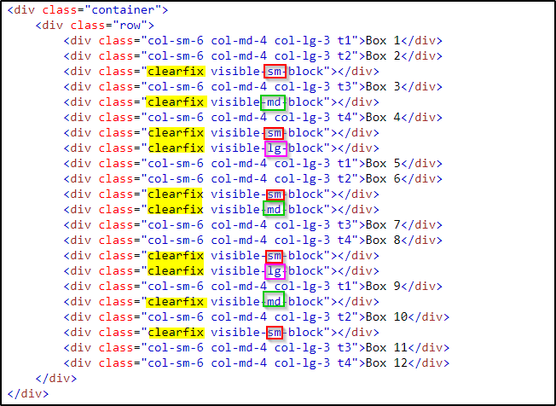
Demo: solving different column height problem
https://www.w3schools.com/code/tryit.asp?filename=FK2RM3A3COWG
Notes:
<!DOCTYPE html>
<html lang="en">
<head>
<meta charset="utf-8">
<meta http-equiv="X-UA-Compatible" content="IE=edge">
<meta name="viewport" content="width=device-width, initial-scale=1">
<title>Example of Bootstrap 3 Multi-Column Grid Layout for All Devices</title>
<link rel="stylesheet" href="https://maxcdn.bootstrapcdn.com/bootstrap/3.3.7/css/bootstrap.min.css">
<script src="https://ajax.googleapis.com/ajax/libs/jquery/1.12.4/jquery.min.js"></script>
<script src="https://maxcdn.bootstrapcdn.com/bootstrap/3.3.7/js/bootstrap.min.js"></script>
<style type="text/css">
.t1{
padding : 50px;
font-weight: bold;
text-align: center;
background: #db33e5;
border:#000000 1px solid;
}
.t2{
padding : 40px;
font-weight: bold;
text-align: center;
background: #dbdfe5;
border:#000000 1px solid;
}
.t3{
padding : 30px;
font-weight: bold;
text-align: center;
background: #dbdf52;
border:#000000 1px solid;
}
.t4 {
padding : 20px;
font-weight: bold;
text-align: center;
background: #33dfe5;
border:#000000 1px solid;
}
</style>
</head>
<body>
<!-- Open the output in a new blank tab (Click the arrow next to "Show Output" button) and resize the window to understand how the Bootstrap responsive grid system works. -->
<div class="container">
<div class="row">
<div class="col-sm-6 col-md-4 col-lg-3 t1">Box 1</div>
<div class="col-sm-6 col-md-4 col-lg-3 t2">Box 2</div>
<div class="clearfix visible-sm-block"></div>
<div class="col-sm-6 col-md-4 col-lg-3 t3">Box 3</div>
<div class="clearfix visible-md-block"></div>
<div class="col-sm-6 col-md-4 col-lg-3 t4">Box 4</div>
<div class="clearfix visible-sm-block"></div>
<div class="clearfix visible-lg-block"></div>
<div class="col-sm-6 col-md-4 col-lg-3 t1">Box 5</div>
<div class="col-sm-6 col-md-4 col-lg-3 t2">Box 6</div>
<div class="clearfix visible-sm-block"></div>
<div class="clearfix visible-md-block"></div>
<div class="col-sm-6 col-md-4 col-lg-3 t3">Box 7</div>
<div class="col-sm-6 col-md-4 col-lg-3 t4">Box 8</div>
<div class="clearfix visible-sm-block"></div>
<div class="clearfix visible-lg-block"></div>
<div class="col-sm-6 col-md-4 col-lg-3 t1">Box 9</div>
<div class="clearfix visible-md-block"></div>
<div class="col-sm-6 col-md-4 col-lg-3 t2">Box 10</div>
<div class="clearfix visible-sm-block"></div>
<div class="col-sm-6 col-md-4 col-lg-3 t3">Box 11</div>
<div class="col-sm-6 col-md-4 col-lg-3 t4">Box 12</div>
</div>
</div>
</body>
</html>

Slide 18
Bootstrap Responsive Utilities Classes

Slide 19
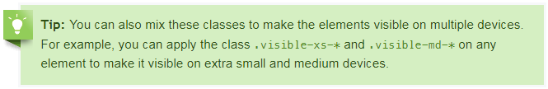
.visible-*-*
the .visible-*-* classes for each breakpoint come in three variations, one for each CSS display property value: inline, block and inline-block. Example
Class | Description
.visible-xs-* | Makes the element visible only on extra small devices having screen width less than 768px. Hidden on others.
.visible-sm-* | Makes the element visible only on small devices having screen width greater than or equal to 768px (i.e. ≥768px) but less than 992px. Hidden on others.
.visible-md-* | Makes the element visible only on medium devices having screen width greater than or equal to 992px (i.e. ≥992px) but less than 1200px. Hidden on others.
.visible-lg-* | Makes the element visible only on large devices having screen width greater than or equal to 1200px (i.e. ≥1200px). Hidden on others.
Notes:
<!DOCTYPE html>
<html lang="en">
<head>
<meta charset="utf-8">
<meta http-equiv="X-UA-Compatible" content="IE=edge">
<meta name="viewport" content="width=device-width, initial-scale=1">
<title>Example of Bootstrap 3 Visible Responsive Classes</title>
<link rel="stylesheet" href="https://maxcdn.bootstrapcdn.com/bootstrap/3.3.7/css/bootstrap.min.css">
<script src="https://ajax.googleapis.com/ajax/libs/jquery/1.12.4/jquery.min.js"></script>
<script src="https://maxcdn.bootstrapcdn.com/bootstrap/3.3.7/js/bootstrap.min.js"></script>
<style type="text/css">
p{
padding: 20px;
background: #FFF0F5;
border-radius: 5px;
}
.bs-example{
margin: 20px;
}
</style>
</head>
<body>
<div class="bs-example">
<p class="visible-xs">This paragraph is visible only on <strong>Extra Small Devices</strong> that has screen width less than <code>768px</code>.</p>
<p class="visible-sm">This paragraph is visible only on <strong>Small Devices</strong> that has screen width greater than equal to <code>768px</code> but less than <code>992px</code>.</p>
<p class="visible-md">This paragraph is visible only on <strong>Medium Devices</strong> that has screen width greater than or equal to <code>992px</code> but less than <code>1200px</code>.</p>
<p class="visible-lg">This paragraph is visible only on <strong>Large Devices</strong> that has screen width greater than or equal to <code>1200px</code>.</p>
</div>
</body>
</html>

Slide 20
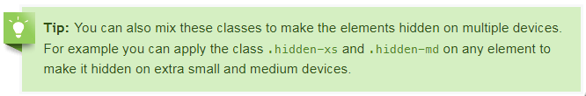
.hidden-*-*
Similarly you can use these hidden utility classes to hide the elements on certain devices. Example
Class | Description
.hidden-xs | Hide the elements only on extra small devices having screen width less than 768px. Visible on others.
.hidden-sm | Hide the elements only on small devices having screen width greater than or equal to 768px (i.e. ≥768px) but less than 992px. Visible on others.
.hidden-md | Hide the elements only on medium devices having screen width greater than or equal to 992px (i.e. ≥992px) but less than 1200px. Visible on others.
.hidden-lg | Hide the elements only on large devices having screen width greater than or equal to 1200px (i.e. ≥1200px). Visible on others.
Notes:
<!DOCTYPE html>
<html lang="en">
<head>
<meta charset="utf-8">
<meta http-equiv="X-UA-Compatible" content="IE=edge">
<meta name="viewport" content="width=device-width, initial-scale=1">
<title>Example of Bootstrap 3 Hidden Responsive Classes</title>
<link rel="stylesheet" href="https://maxcdn.bootstrapcdn.com/bootstrap/3.3.7/css/bootstrap.min.css">
<script src="https://ajax.googleapis.com/ajax/libs/jquery/1.12.4/jquery.min.js"></script>
<script src="https://maxcdn.bootstrapcdn.com/bootstrap/3.3.7/js/bootstrap.min.js"></script>
<style type="text/css">
p{
padding: 20px;
background: #E6E6FA;
border-radius: 5px;
}
.bs-example{
margin: 20px;
}
</style>
</head>
<body>
<div class="bs-example">
<p class="hidden-xs">This paragraph is <mark>hidden only on</mark> <strong>Extra Small Devices</strong> that has screen width less than <code>768px</code>.</p>
<p class="hidden-sm">This paragraph is <mark>hidden only on</mark> <strong>Small Devices</strong> that has screen width greater than equal to <code>768px</code> but less than <code>992px</code>.</p>
<p class="hidden-md">This paragraph is <mark>hidden only on</mark> <strong>Medium Devices</strong> that has screen width greater than or equal to <code>992px</code> but less than <code>1200px</code>.</p>
<p class="hidden-lg">This paragraph is <mark>hidden only on</mark> <strong>Large Devices</strong> that has screen width greater than or equal to <code>1200px</code>.</p>
</div>
</body>
</html>

Slide 21
Practice
Try using .visible-*-* and .hidden-*-* to display and hide some elements.

Slide 22
Offsetting the Grid Columns
Moving grid columns to the right for alignment purpose using the column offset classes like .col-md-offset-*, .col-sm-offset-*, etc.
These classes offset the columns by simply increasing its left margin by specified number of columns.
For example, the class .col-sm-offset-4 on the column .col-sm-8 moves it to the right over four columns from its original position.
https://www.w3schools.com/code/tryit.asp?filename=FK2T2R1MW8F6
Try it yourself
Notes:
<!DOCTYPE html>
<html lang="en">
<head>
<meta charset="utf-8">
<meta http-equiv="X-UA-Compatible" content="IE=edge">
<meta name="viewport" content="width=device-width, initial-scale=1">
<title>Example of Bootstrap 3 Columns Offsetting</title>
<link rel="stylesheet" href="https://maxcdn.bootstrapcdn.com/bootstrap/3.3.7/css/bootstrap.min.css">
<script src="https://ajax.googleapis.com/ajax/libs/jquery/1.12.4/jquery.min.js"></script>
<script src="https://maxcdn.bootstrapcdn.com/bootstrap/3.3.7/js/bootstrap.min.js"></script>
<style type="text/css">
/* Some custom styles to beautify this example */
.demo-content{
padding: 15px;
font-size: 18px;
min-height: 75px;
background: #dbdfe5;
margin-bottom: 10px;
}
.demo-content.bg-alt{
background: #abb1b8;
}
</style>
</head>
<body>
<!-- Open the output in a new blank tab (Click the arrow next to "Show Output" button) and resize the browser window to understand how the Bootstrap responsive grid system works. -->
<div class="container">
<div class="row">
<div class="col-sm-4">
<div class="demo-content">.col-sm-4</div>
</div>
<div class="col-sm-8">
<div class="demo-content bg-alt">.col-sm-8</div>
</div>
</div>
<div class="row">
<div class="col-sm-8 col-sm-offset-4">
<div class="demo-content bg-alt">.col-sm-8 .col-sm-offset-4</div>
</div>
</div>
<hr>
<div class="row">
<div class="col-sm-3">
<div class="demo-content">.col-sm-3</div>
</div>
<div class="col-sm-9">
<div class="demo-content bg-alt">.col-sm-9</div>
</div>
</div>
<div class="row">
<div class="col-sm-6 col-sm-offset-3">
<div class="demo-content bg-alt">.col-sm-6 .col-sm-offset-3</div>
</div>
<div class="col-sm-3">
<div class="demo-content">.col-sm-3</div>
</div>
</div>
<hr>
<div class="row">
<div class="col-sm-3">
<div class="demo-content">.col-sm-3</div>
</div>
<div class="col-sm-3">
<div class="demo-content bg-alt">.col-sm-3</div>
</div>
<div class="col-sm-3">
<div class="demo-content">.col-sm-3</div>
</div>
<div class="col-sm-3">
<div class="demo-content bg-alt">.col-sm-3</div>
</div>
</div>
<div class="row">
<div class="col-sm-3 col-sm-offset-3">
<div class="demo-content bg-alt">.col-sm-3 .col-sm-offset-3</div>
</div>
<div class="col-sm-3 col-sm-offset-3">
<div class="demo-content">.col-sm-3 .col-sm-offset-3</div>
</div>
</div>
</div>
</body>
</html>

Slide 23
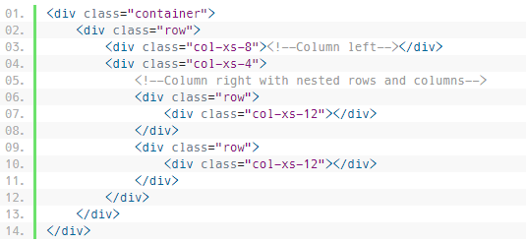

Nesting of Grid Columns
The Bootstrap grid columns are nestable, that means you can put rows and columns inside an existing column.
Practice: making an 18 equal column layout

